Slide 1
WORLD OF DRONE
Drone Components: Body and Power Supply

Slide 2
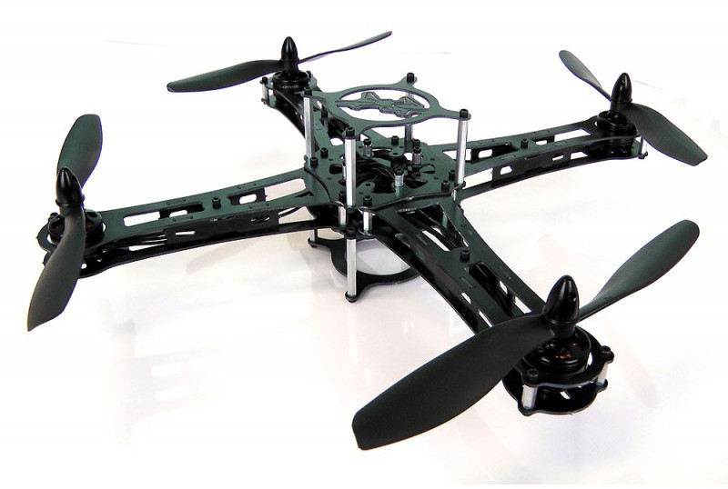
DRONE BODY?
The primary difference for planes is the absence of the cockpit area and its windows.

Slide 3
DRONE BODY?
Tailless Quadcopters are a common form factor for rotary wing UAVs while tailed mono- and bi-copters are common for manned platforms.

Slide 4
DRONE BATTERY
Small UAVs mostly use lithium-polymer batteries (Li-Po), while larger vehicles rely on conventional airplane engines.

Slide 5
DRONE BODY?
Battery elimination circuitry (BEC) is used to centralize power distribution and often harbors a microcontroller unit (MCU).
Costlier switching BECs diminish heating on the platform.

Slide 6
?
WELL DONE!
Now you can move on to the next topic...
Drone Components: Sensors and Actuators!

